Slide 1

Market Basket Analysis
Soham Sharma
(data analytics intern)

Slide 2
Market basket analysis
Market Basket Analysis (MBA) is a data mining technique used to understand customer purchasing behavior by identifying patterns and relationships among items in transactional data. This method is widely employed in retail to suggest products, manage inventory, and optimize store layouts.
Example: Market Basket Analysis for an E-commerce Retailer
Objective: An online retailer wants to improve its product recommendation engine to boost cross-selling and increase the average order value. By analyzing historical transaction data, the retailer can determine products that are often bought together and recommend them to customers.

Slide 3
Dataset: The retailer’s transaction data consists of thousands of transactions with multiple products purchased in each transaction. The fields in the dataset include:
Transaction ID
Product ID
Product Category
Quantity
Purchase Date

Slide 4
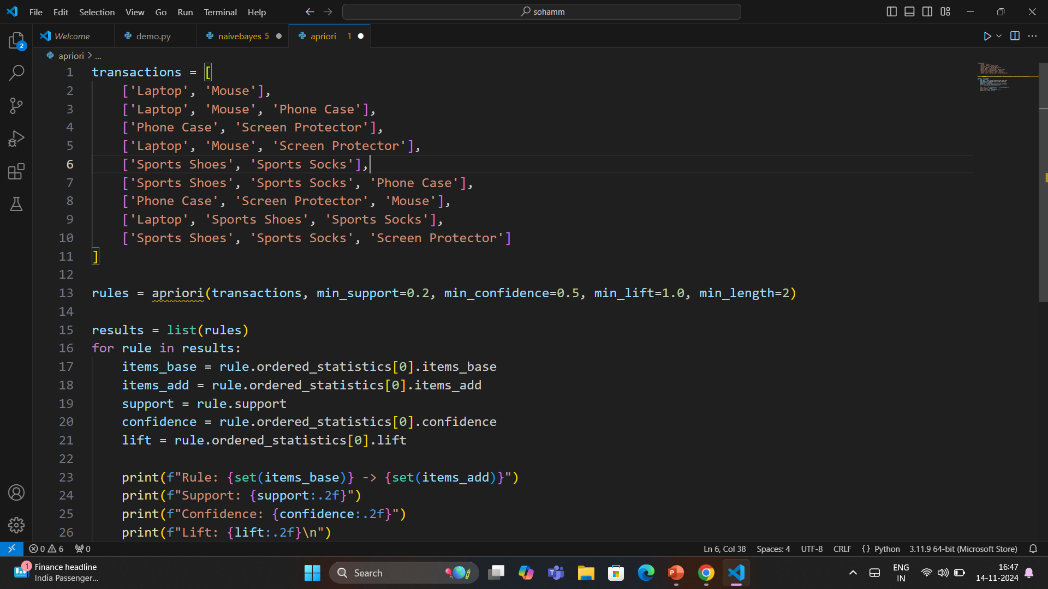

Slide 5
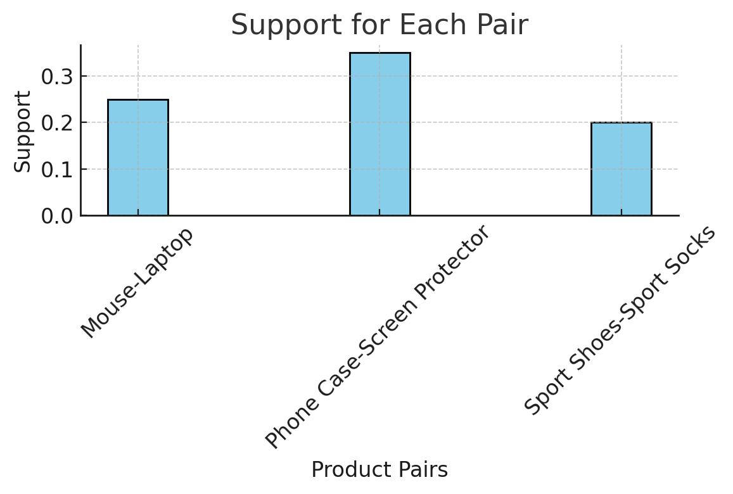
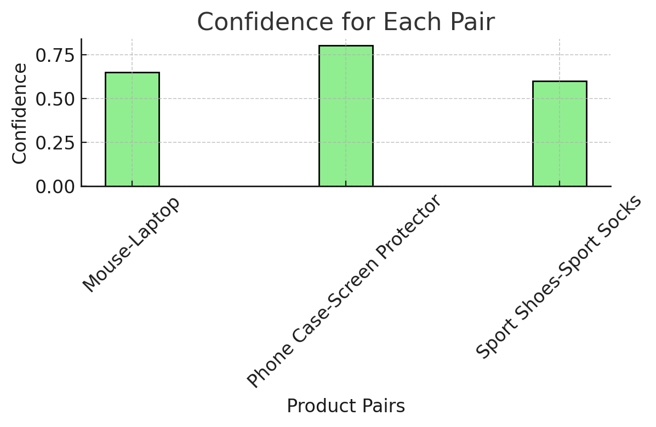
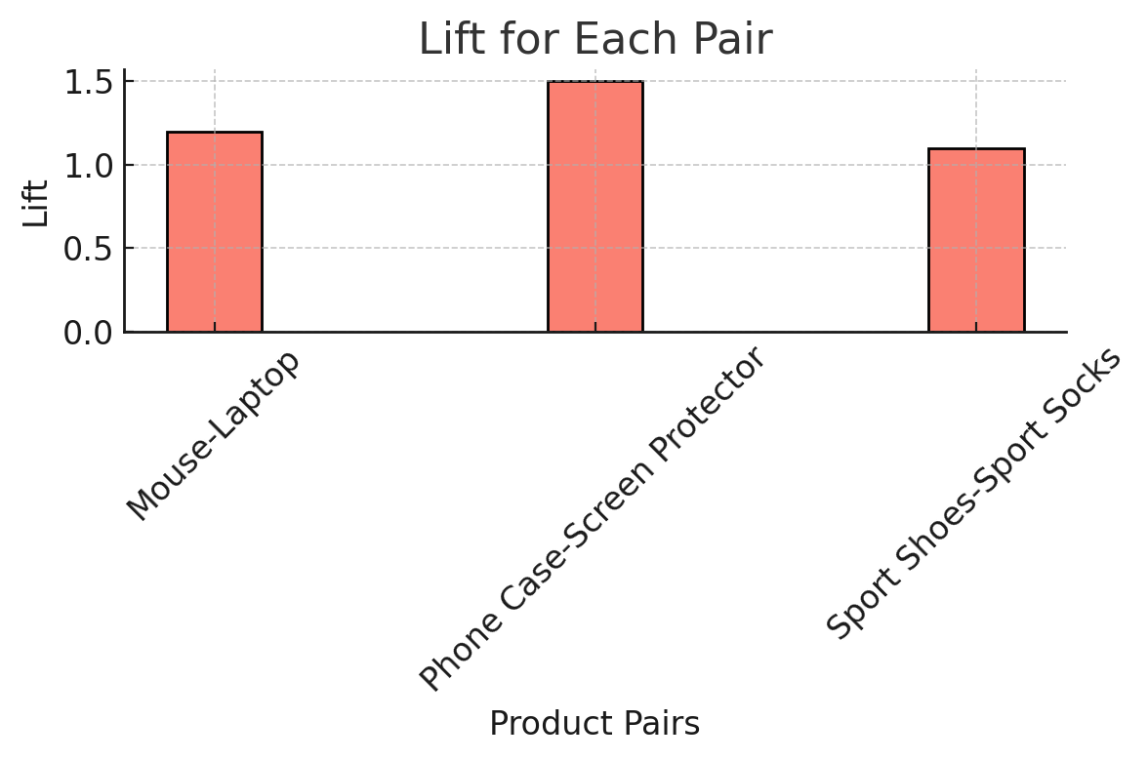
Bar Graphs

Slide 6
Methodology:
1. Data Preparation: Transactions are organized into a format where each row represents a single transaction, listing the items purchased together.
2. Association Rule Mining: Using algorithms like the Apriori algorithm, the retailer identifies frequent item sets and association rules. Key metrics calculated include:
Support: The frequency with which an item or itemset appears in transactions.
Confidence: The likelihood that when a customer buys item A, they will also buy item B .
Lift: Measures how much more likely item B is to be bought when item A is bought, compared to B being bought independently
Example Rules Extracted:
{Laptop} → {Mouse}: Customers who buy laptops frequently purchase a mouse. The rule has a high lift, suggesting that a mouse is purchased significantly more often with a laptop.
{Phone Case, Screen Protector}: These items are often bought together, showing strong support and confidence, as customers typically want to protect their phones immediately upon purchase.
{Sports Shoes} → {Sports Socks}: There is a high confidence level in this rule, indicating customers buying sports shoes often add socks to their cart.

Slide 7
4. Implementing Results:
Cross-Selling Recommendations: Based on the identified rules, the e-commerce site can recommend relevant items. For instance, when a customer views a laptop, they might see a suggestion for a mouse or a carrying case.
Optimized Promotions: Bundles, discounts, and promotions can be created for commonly purchased pairs, like "buy a phone case and get a discount on a screen protector.“
Inventory Management: Understanding high-frequency combinations helps the retailer stock items effectively, reducing instances of out-of-stock products for popular pairs.
Outcome:
By leveraging market basket analysis, the retailer observed a significant increase in cross-selling. Recommendations based on historical data enhanced the user experience and provided a personalized shopping experience, leading to a higher average order value and better customer satisfaction.

